Slide 1

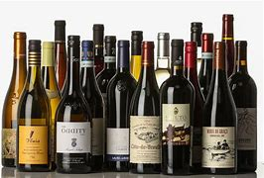
Term 1 &2 EDA Project
Wine Quality Dataset
Presented by Clifer Fernandez – April 2020 cohort

Slide 2
Agenda
Introduction
Executive Summary
Data Profiling
Data Analysis
Conclusions
Recommendations

Slide 3
Introduction
Dataset - Properties of Wine
11 physiochemical properties
1 Sensory property : ‘Quality’– based on taste
The Challenge!
Can we predict the quality of a wine based on these 12 properties?

Slide 4
Executive Summary
Original data set – 6497 records
Analysis indicates
No clear combination of properties
High quality wines
higher alcohol levels
lower residual sugar, chlorides and volatile acidity
Further actions
Additional data collection eg: Red / White / Rosé
Current analysis and data - select / develop Machine Learning Models that may be able to predict

Slide 5
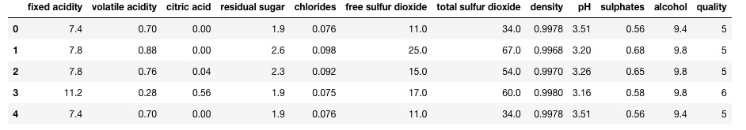
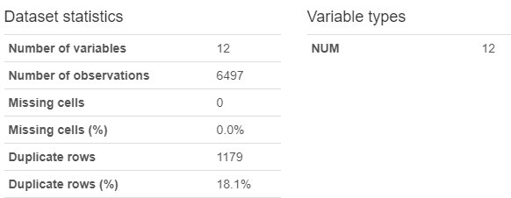
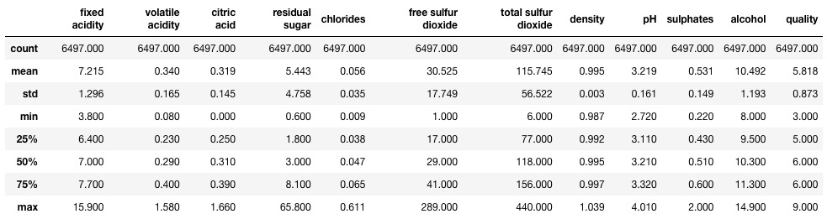
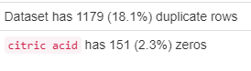
Data Profiling
Data set
Import data
View records
Basic stats
Profiling

Slide 6
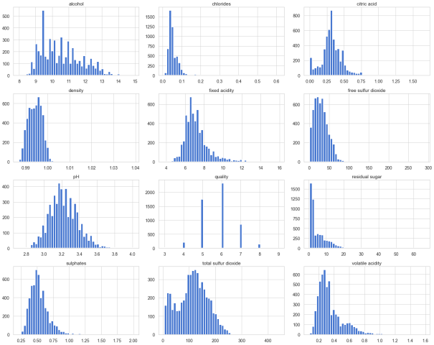
Data Profiling - Pre-processing
Pre-processing
Remove duplicates
Set reduced to 5318 records
Check data distribution

Slide 7
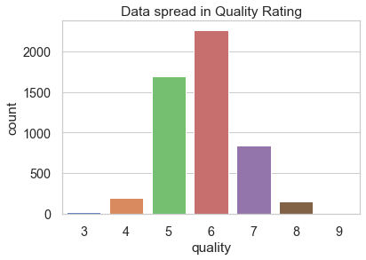
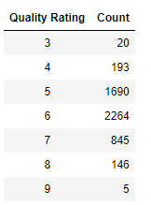
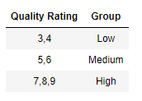
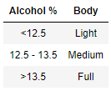
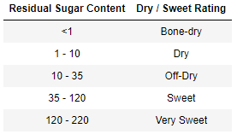
Data Profiling – feature eng.
Pre-processing
Deal with outliers
z score - 4 to +4
Removed 155 records
Final dataset has 5163 records
Add feature
Wine grade
Wine body
Link
Dryness / sweet
Link

Slide 8
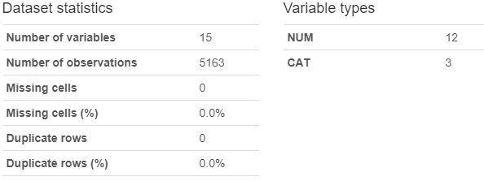
Data Profiling – Post Profiling
Post Profiling
Rerun stats
profiling

Slide 9
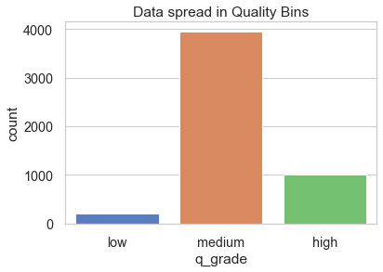
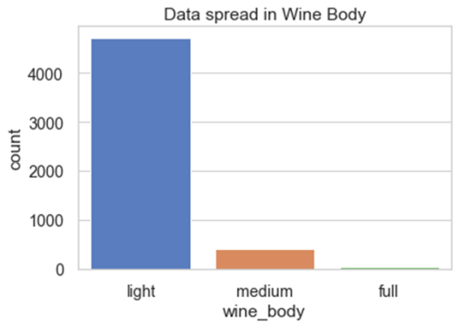
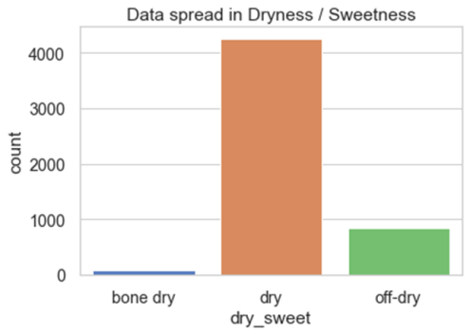
Data Analysis
Data spread – new categories
Quality grade
Low – 213
Medium – 3954
High – 996
Wine Body
Light – 4721
Medium – 395
Full – 47
Dryness / Sweetness
Bone-dry – 72
Dry – 4264
Off-dry – 827
Medium grade, Light bodied, Dry wines

Slide 10
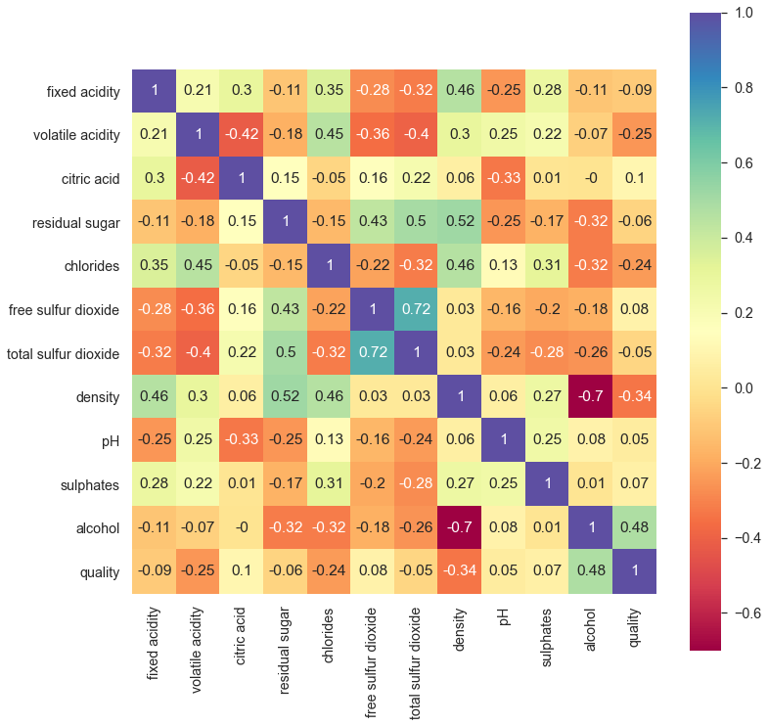
Data Analysis
Correlation of the variables
Quality
Alcohol content
Density
Chlorides (salts)
Volatile acidity (acetic acid levels)

Slide 11
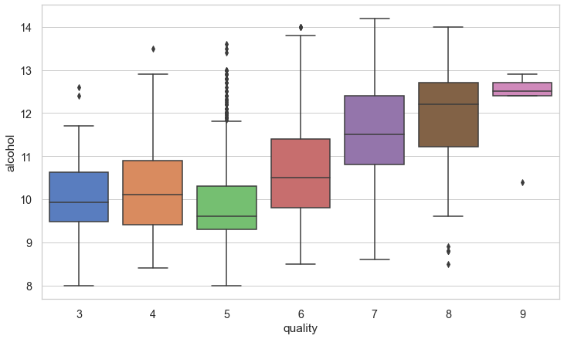
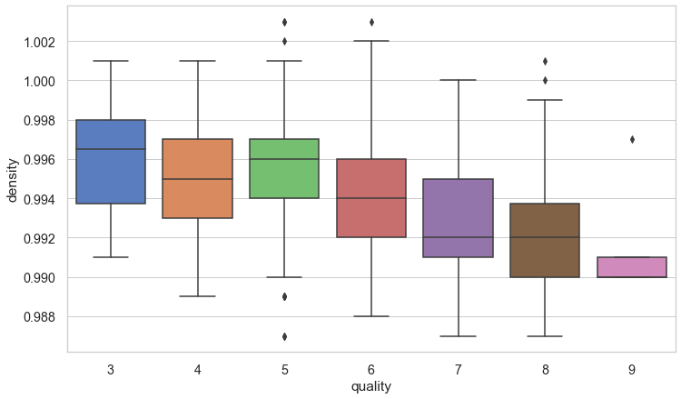
Data Analysis - Quality
Variables correlating with Quality
vs Alcohol content
Higher the quality grade higher the alcohol level
vs Density
Higher the quality grade lower the density

Slide 12
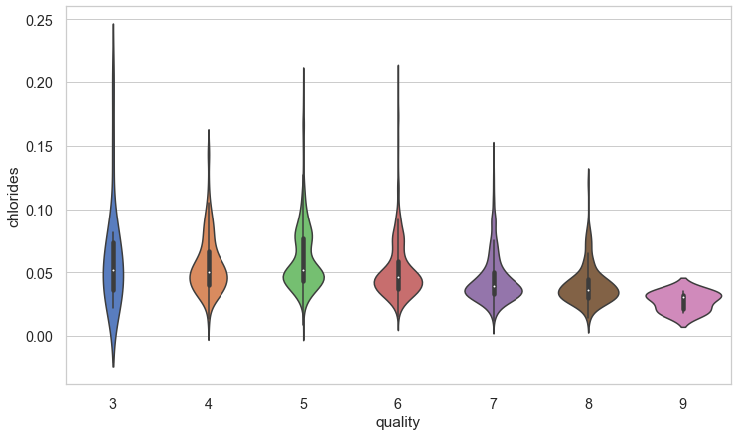
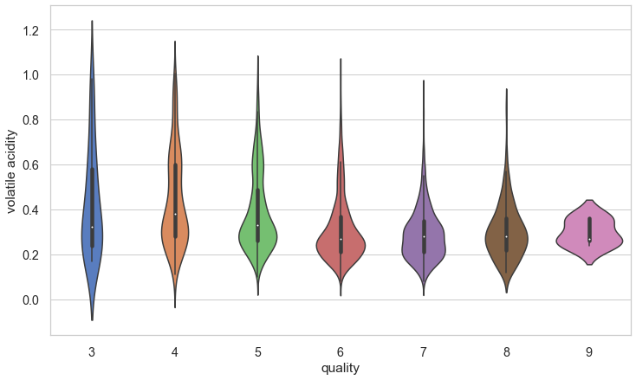
Data Analysis - Quality
Variables correlating with Quality
vs Chloride levels
Higher the quality grade lower the chloride levels
vs Volatile acidity
Higher the quality grade lower the volatile acidity

Slide 13
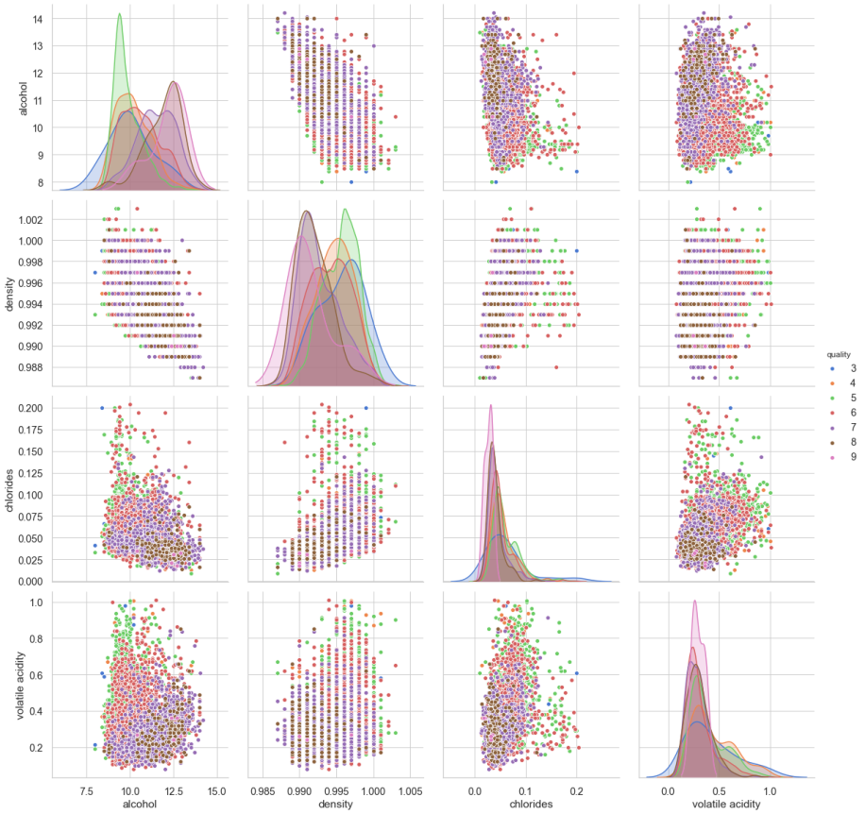
Data Analysis - Quality
Variables correlating with Quality
Reiterates what we seen
Note -
Chloride and Volatile acidity grouping irrespective of quality grade
How much do they really affect the quality rating?

Slide 14
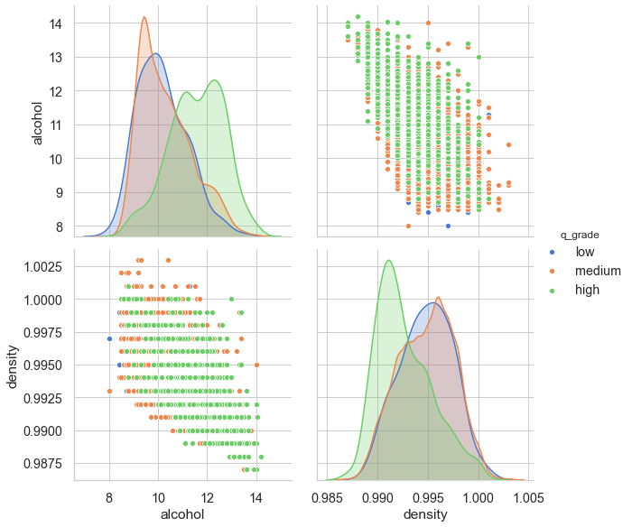
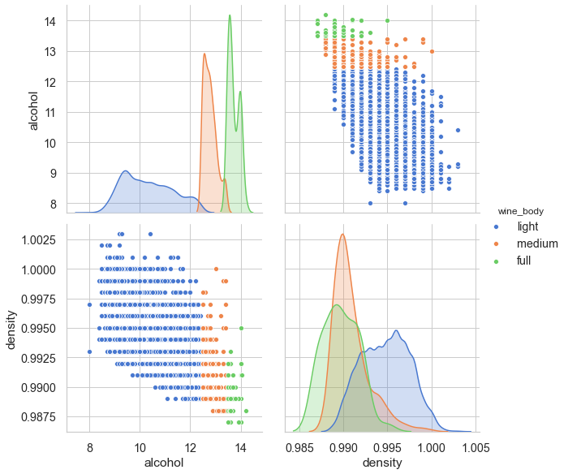
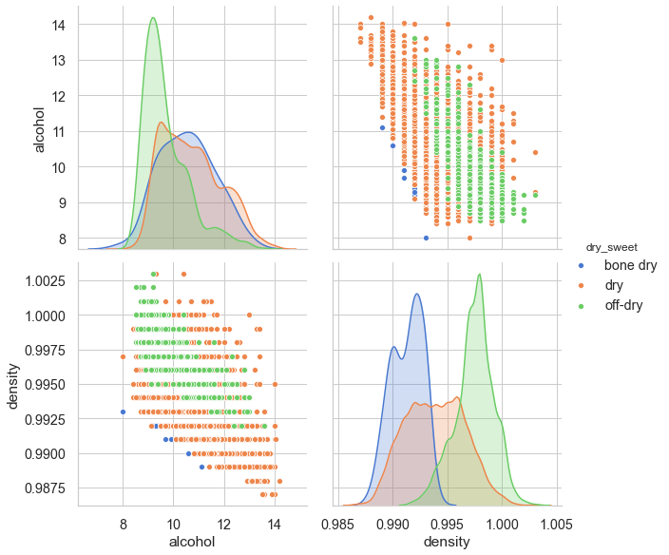
Data Analysis - Quality
Sweeter wines have higher density
Higher quality wines have higher alcohol content
Lighter wines have higher density

Slide 15
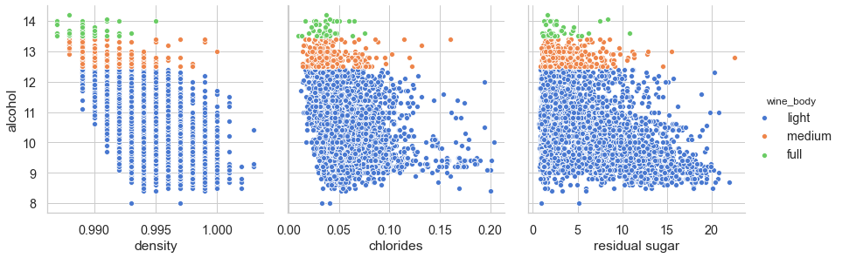
Data Analysis – Alcohol content
Variables correlating with Alcohol content
vs Density
Higher the alcohol content lower the density
vs Chlorides
Low correlation, data is spread out
Generally higher the alcohol content lower the chlorides
Vs Residual sugar
Higher the alcohol content lower the residual sugar

Slide 16
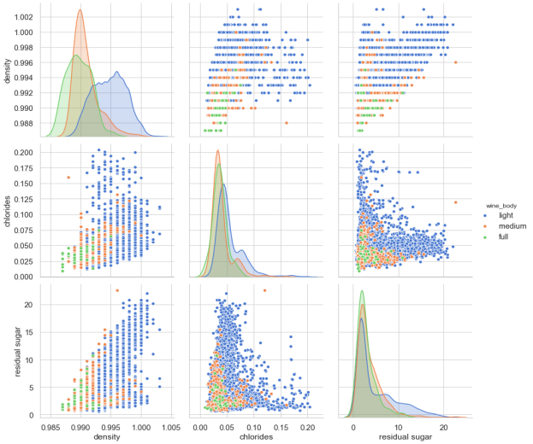
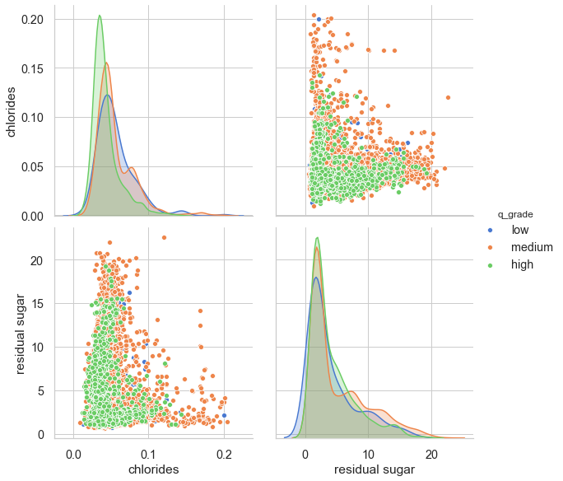
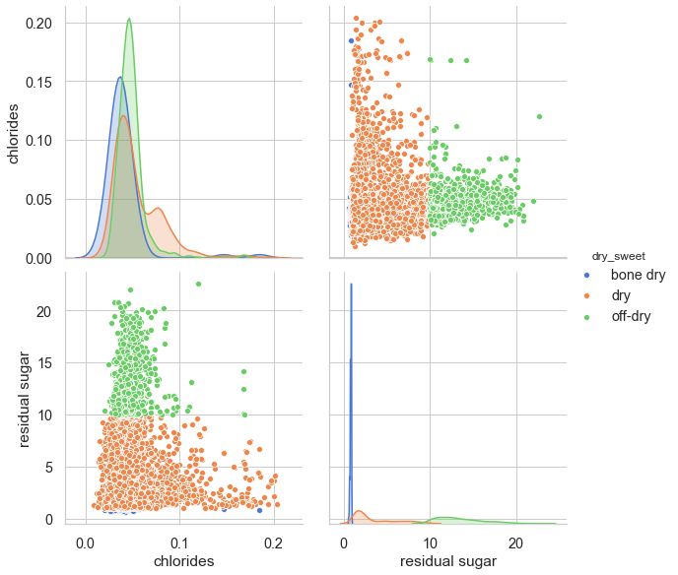
Data Analysis – Alcohol content
The cross plot of residual sugar Vs chlorides
An obvious ‘V’ shaped spread
Could indicate 2 distinct families of wines
Higher residual sugars and higher density are seen in light wines ie: lower alcohol wines
Notes:
Test notes hree

Slide 17
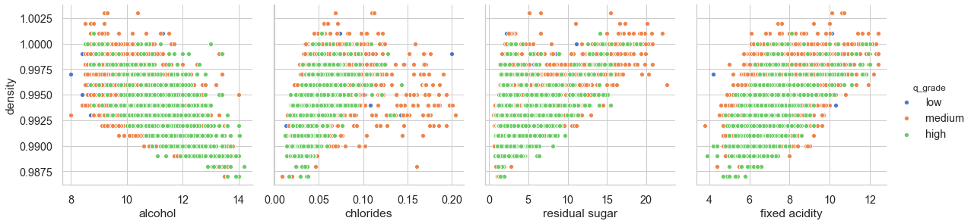
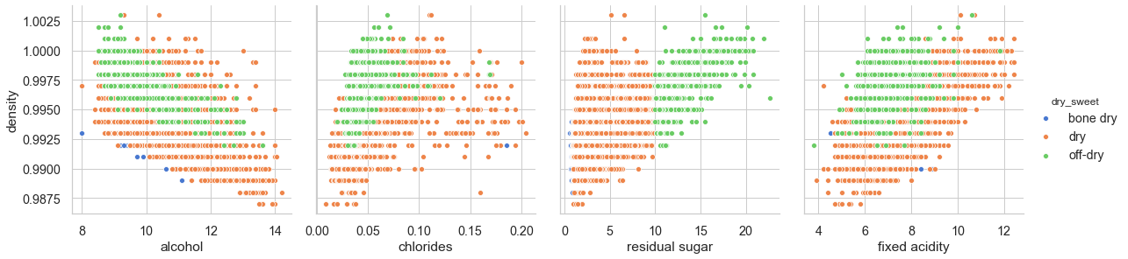
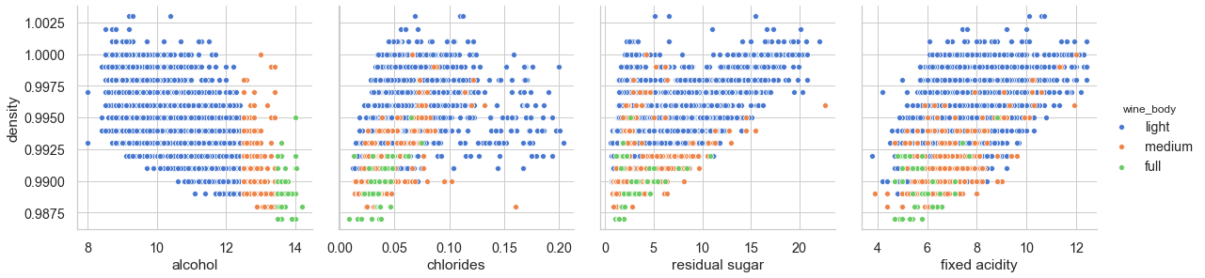
Data Analysis – Density
Variables correlating with Density
vs Fixed acidity
Higher the density higher the fixed acidity

Slide 18
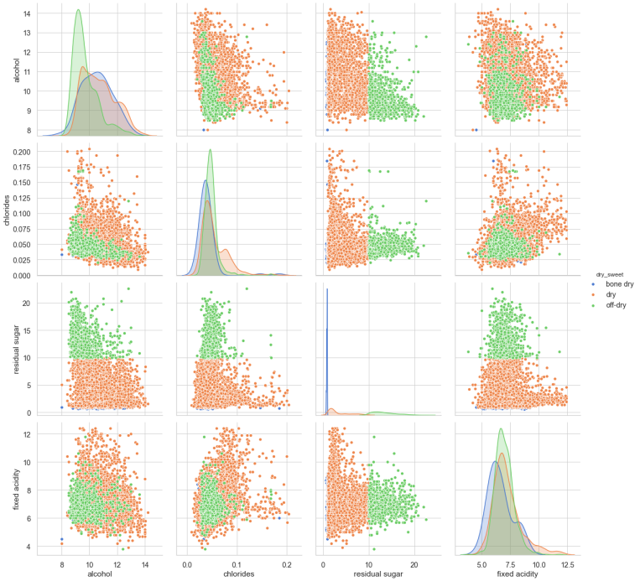
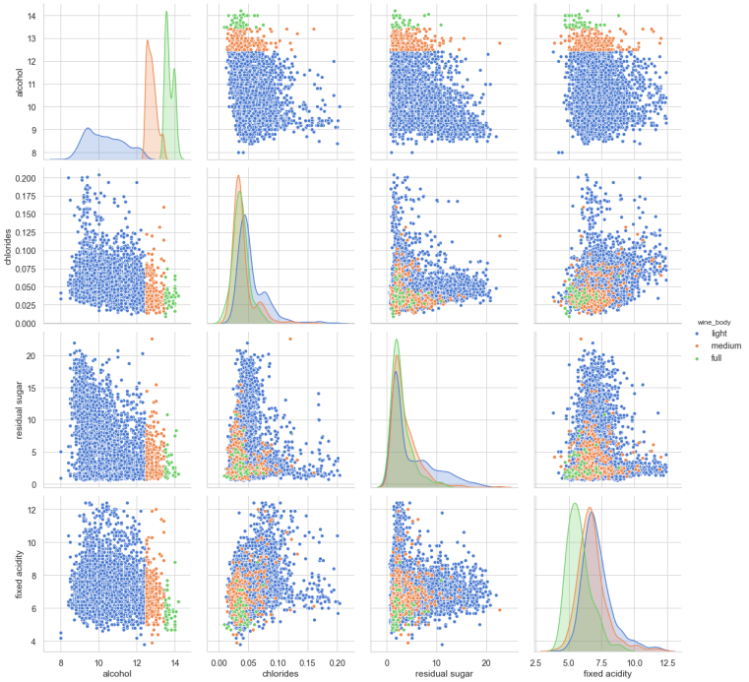
Data Analysis – Density
Variables correlating with Density

Slide 19
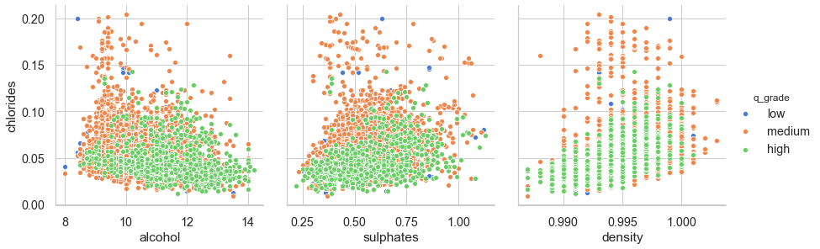
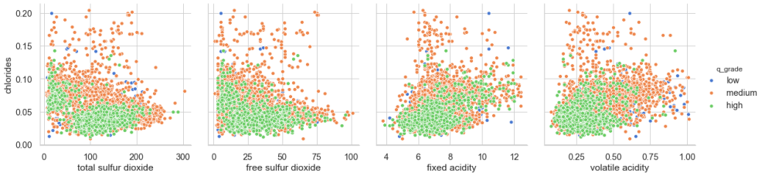
Data Analysis – Chlorides
Variables correlating with Chlorides
Data is quiet spread out with weak relationships
Generally higher grade wines have lower chloride content

Slide 20
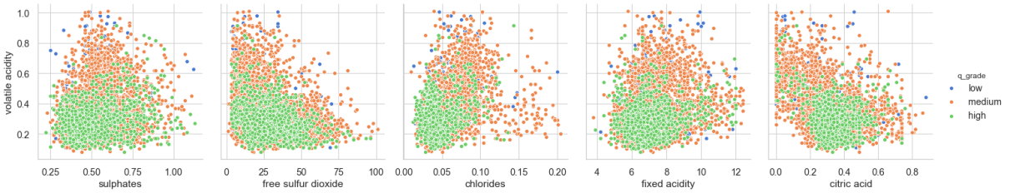
Data Analysis – Volatile Acidity
Variables correlating with Volatile Acidity
Higher quality wines tend to have lower levels of volatile acidity
Also tend to have lower levels of the ingredients that correlate with Volatile Acidity

Slide 21
Conclusions
Dataset concentrated on Medium graded, light bodied , dry wines
Broadly speaking higher the quality of wine
Higher : alcohol content - (human factor?)
Lower : density , residual sugar, chlorides and volatile acidity

Slide 22
Conclusions
No clear combination of physicochemical properties can be summarised by EDA

Slide 23
Recommendations
Data collection
Wine type ie: Red, White or Rosé
Variety of grape
Origin of wine ie: local, region, country etc.
Current dataset
Select / build Machine Learning models to predict quality rating based on the physicochemical properties
Additional data from the above collection can be used to improve selected model or select a more appropriate model as necessary

Slide 24


Thank You!
Santé!

